Slide 1








Single-Family Residence
PD, LGD Model Implementation & RWA Assessment
Presented by Mengya Wu

Slide 2

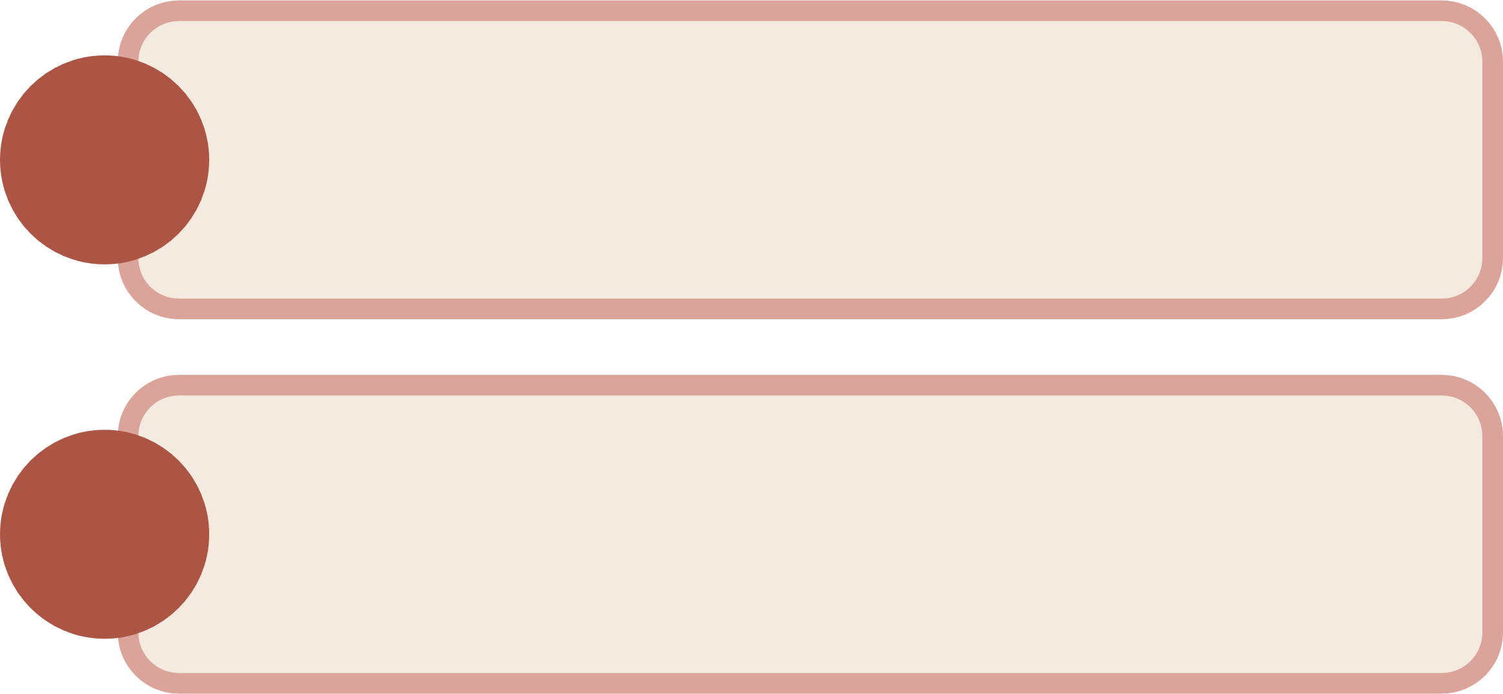
Project Goals
1.
To create PD & LGD model for credit risk assessment of the single-family residence loan portfolio
2.
Calculation of RWA to determine the minimum amount of capital a financial institution must have to reduce risk of insolvency with major input of PD & LGD & Capital Requirement & EAD

Slide 3



Requirement Files
Retail loan details
( primary keys )
Beacon score & BNI score (applicant)
Imported 8 CVS tables to construct the relational database
7 WOE transformation related files for model drivers
HPI index for national & province level
Moody unemployment rate historical & forecast
Metro Mapping & province Mapping
6 WOE transformation files and 1 WOE coefficient file

Slide 4





PD Model Drivers
Current LTV including Partner Adjusted by HPI Segmented by Alt/Prime
Age_At_SL
Current Max Beacon & BNI of applicant
Delinquency status
First difference of National unemployment rate
Province & Metro
Funding TDS & Funding GDS ratio
Logistic regression estimates the probability of an event occurring (categorical event)
Formula: PD = 1 / (1 + exponential(-K))
where K = Intercept + (β1 * X1) + (β2 * X2) + … + (βn * Xn)
X: model driver
Beta(β): model parameter
Result range (0, 1)

Slide 5
LGD Model Drivers
Current LTV Excluding Partner Adjusted by HPI from Provincial Level
Current Appraisal Value Adjusted by HPI from Provincial Level
Current Max BNI Score among Applicant
Mortgage Interest Rate
Province
Unemployment rate with a quarter lag

Slide 6
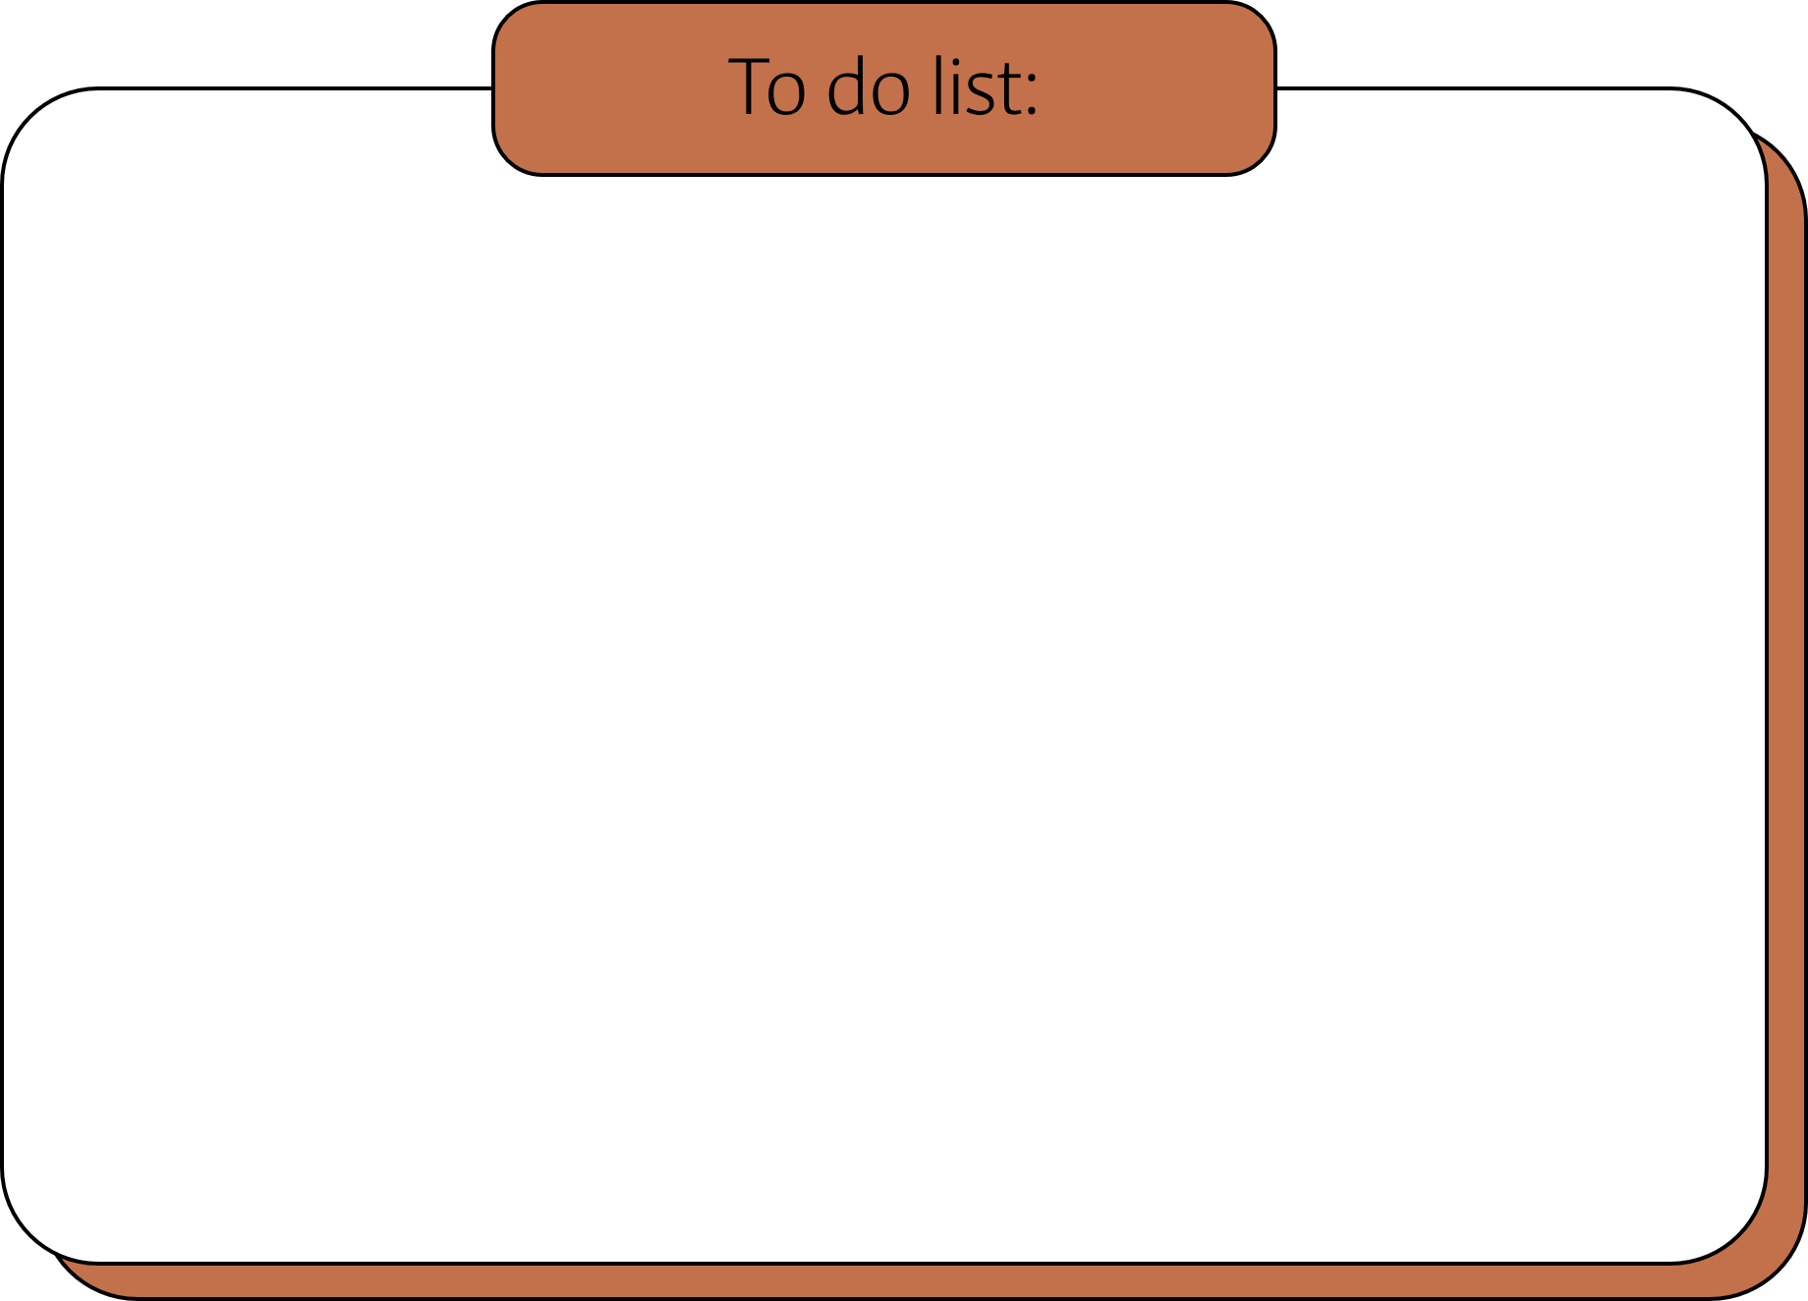
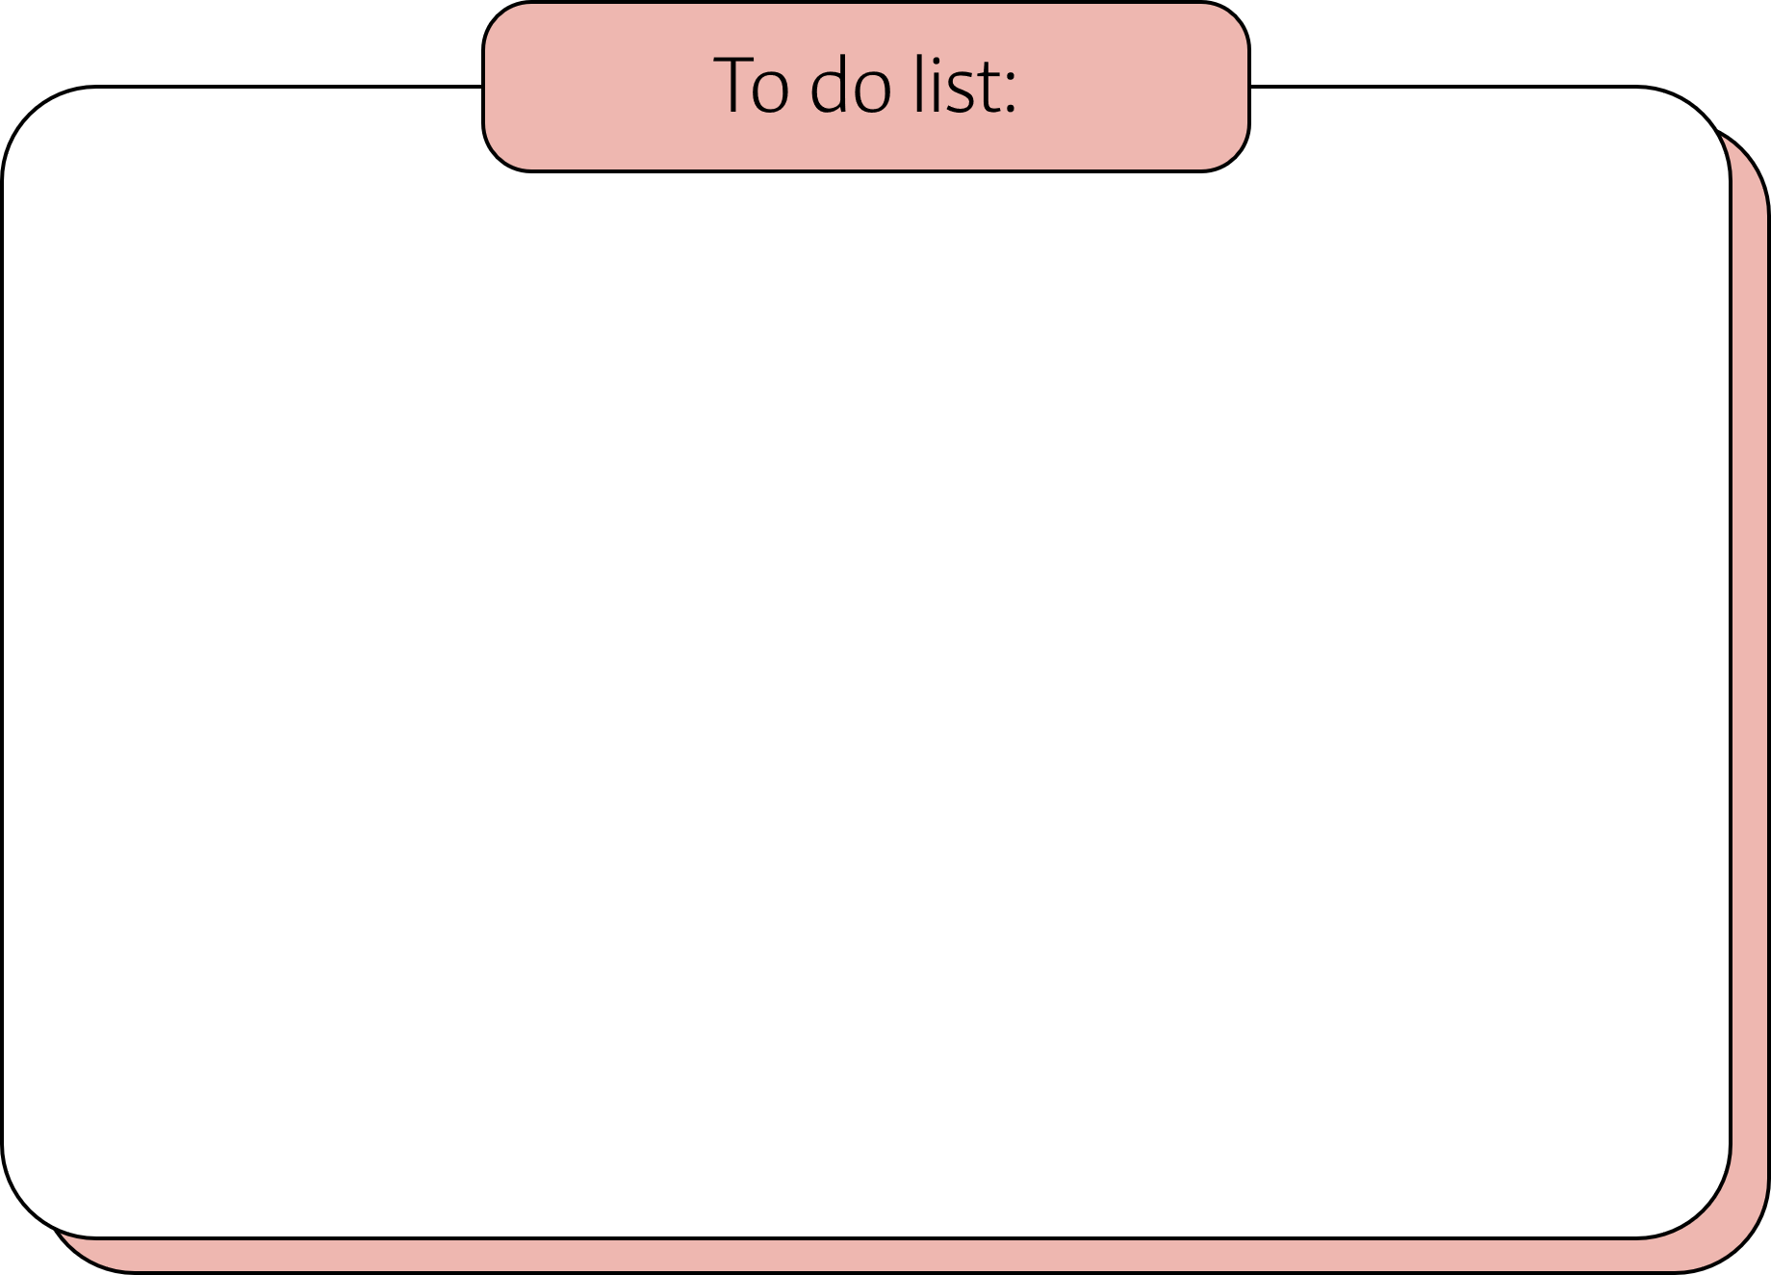
Technical Tools
SQL
Python
MySQL database and IDE platform Datagrip
Join, variable, case when, stored procedure etc.
Anaconda Navigator ----Jupiter Notebook
Pandas, Numpy libraries etc.

Slide 7

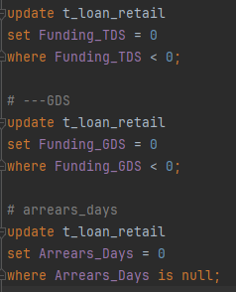
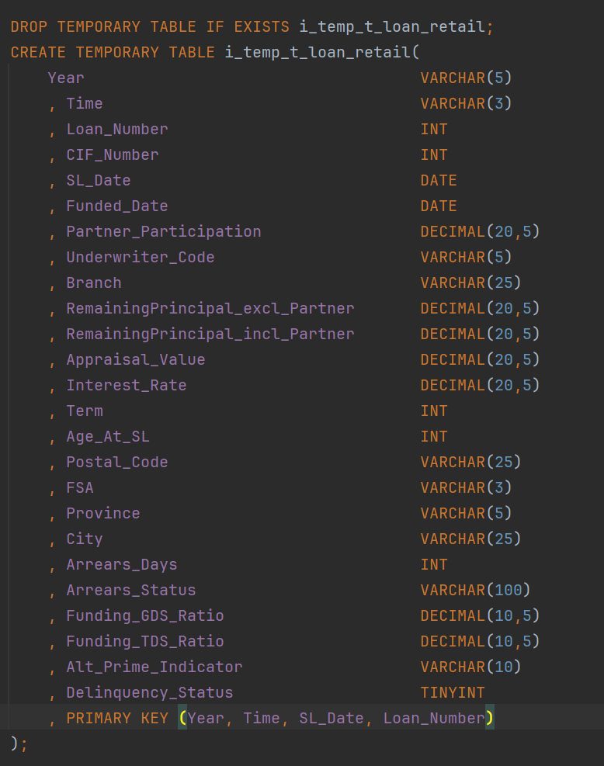

PD Model
Data manipulation: creation of 8 tables and data import
Data Cleaning – handling missing data or outliers : set cap or floor to outliers assign a value to missing value
Created temporary tables to restore data
Code Flow….

Slide 8
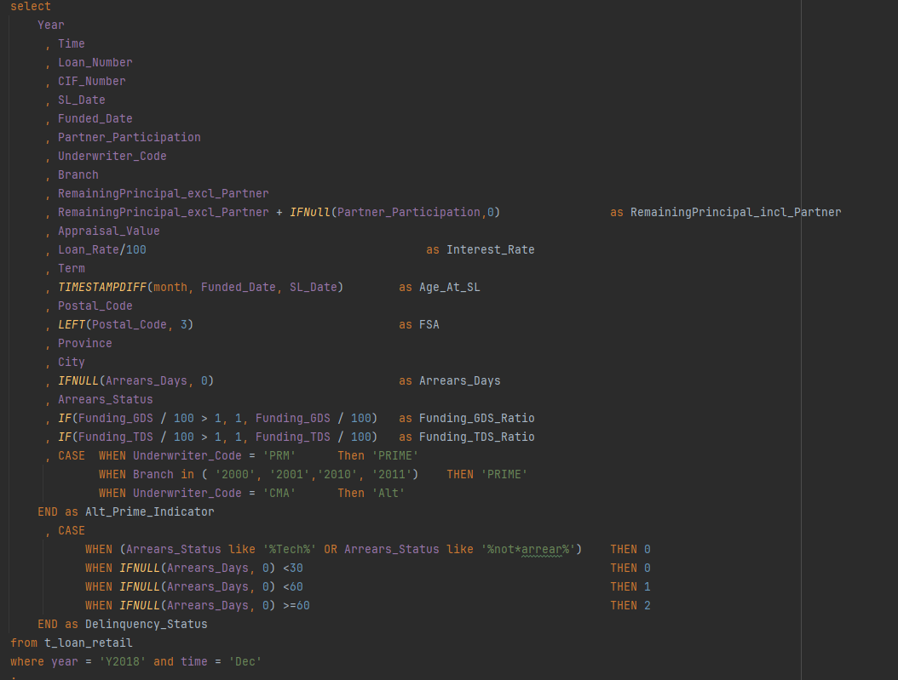
PD Model
Extraction of key data, existing model drivers
Data Transformation: conversion of data format, data aggregation, calculations of source model drivers

Slide 9
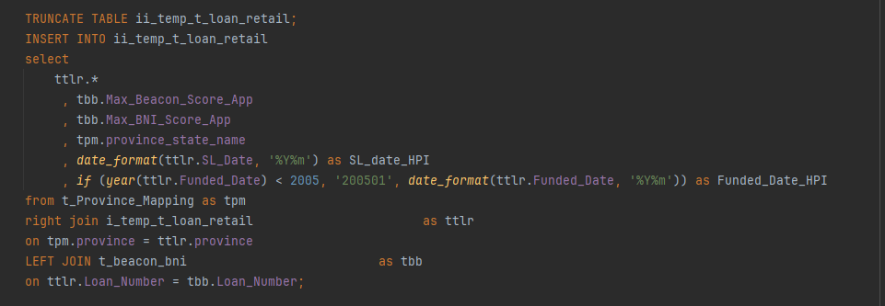
PD Model
Extraction of key data, existing model drivers
Data Transformation: conversion of data format, data aggregation, calculations of source model drivers

Slide 10
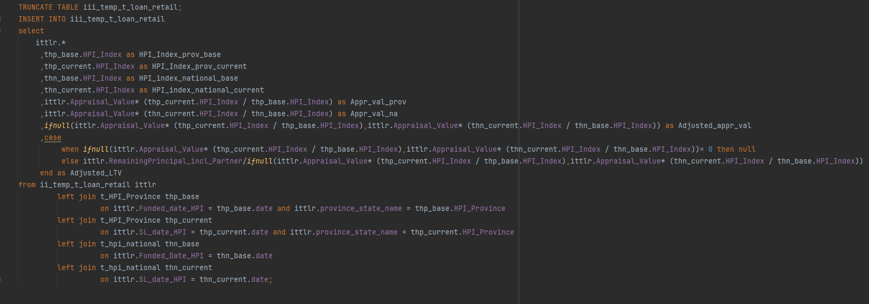
PD Model
HPI provincial and national tables joined to main tables
Adjusted HPI, Appraisal value and LTV calculation
Unemployment rate difference 1 quarter lag

Slide 11
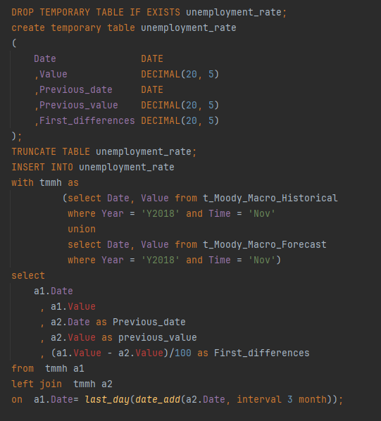
PD Model
HPI provincial and national tables joined to main tables
Adjusted HPI, Appraisal value and LTV calculation
Unemployment rate difference 1 quarter lag

Slide 12
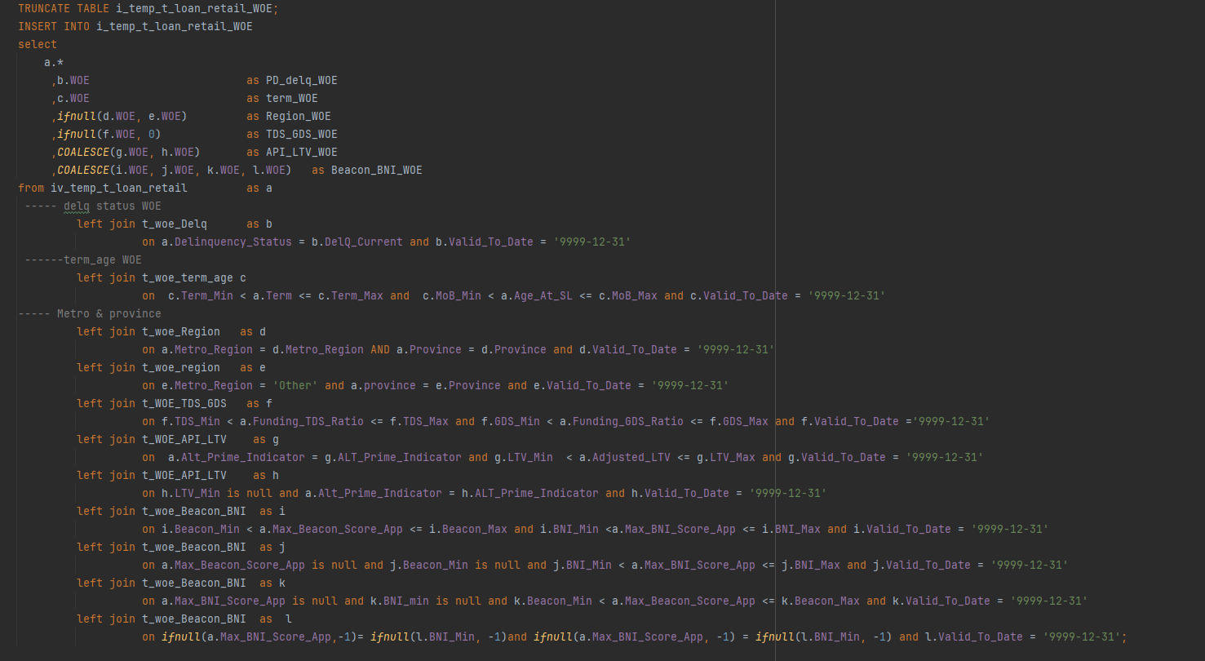
PD Model
WOE transformation for each model drivers (join function)
Set WOE coefficient value into variable to support automation
Calculation of PD
Create a stored procedure

Slide 13
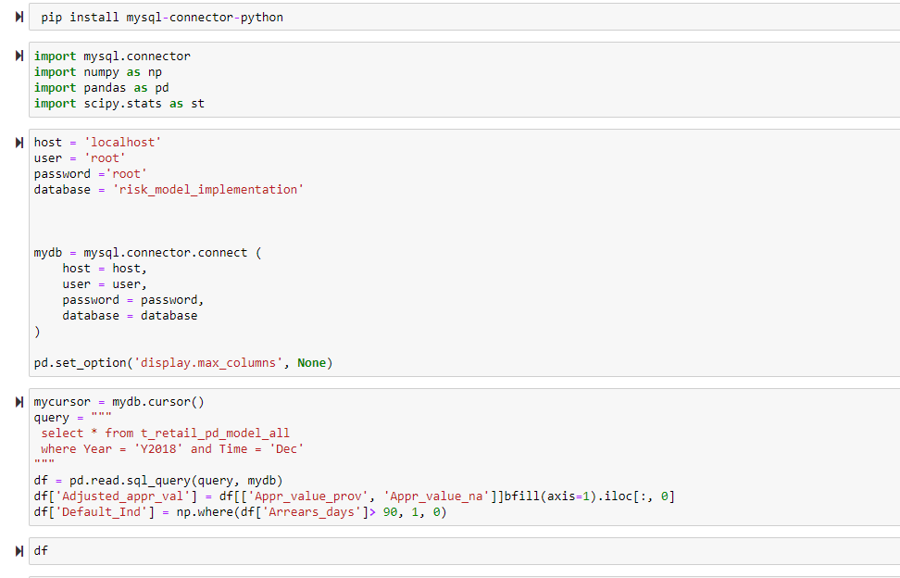
LGD & RWA
Establish connection to SQL database
Import of libraries

Slide 14
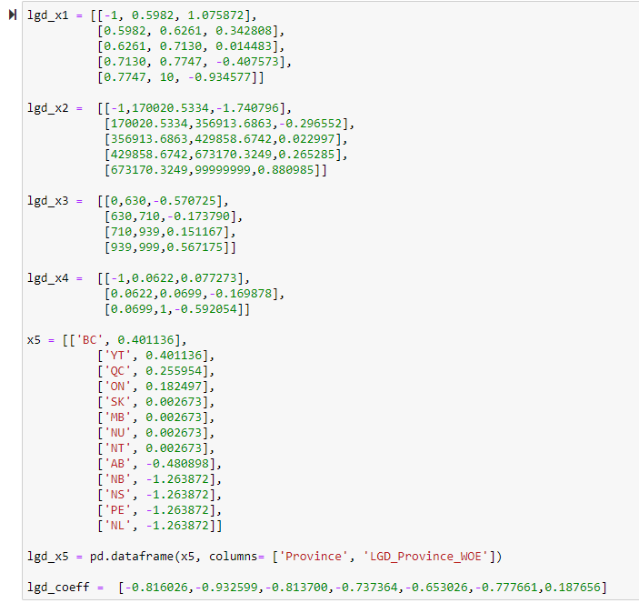
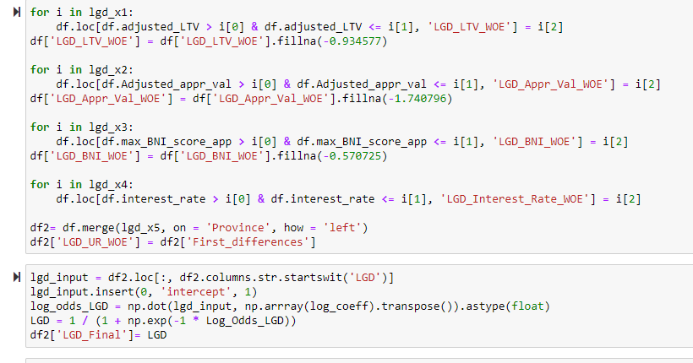
LGD & RWA
WOE transformation for LGD model drivers
Conversion WOE values into list and dataframe
For loop to extract WOE value and merge function

Slide 15
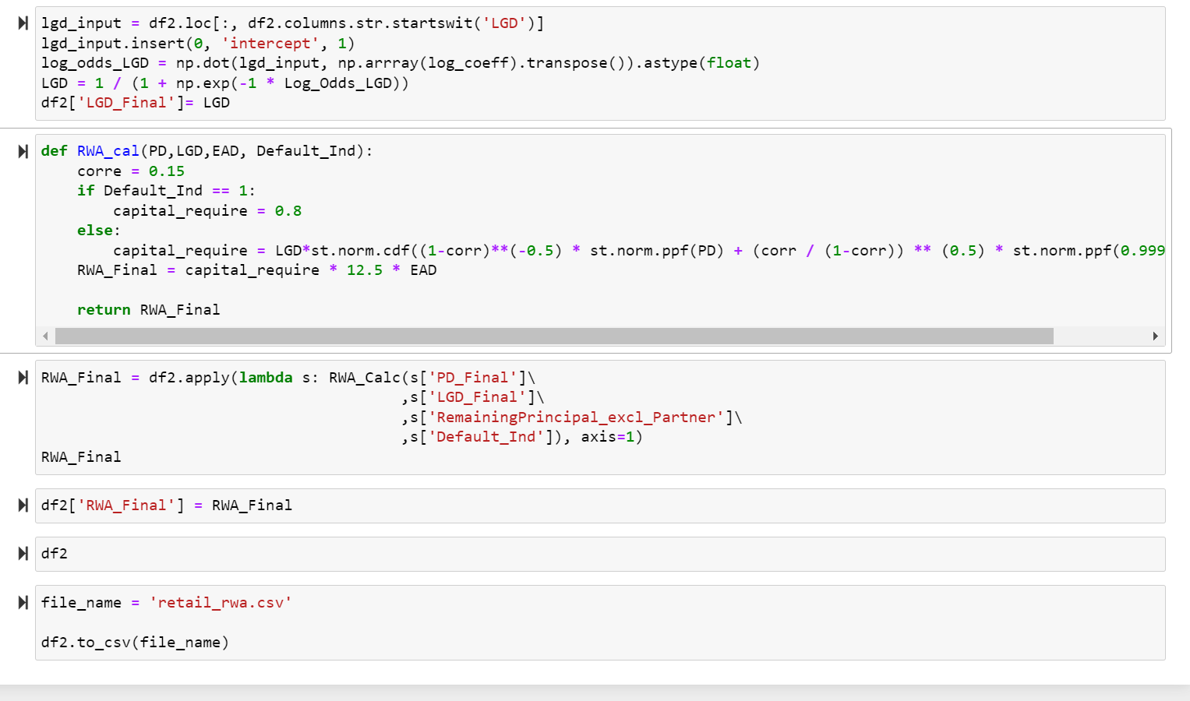
LGD & RWA
Calculation of Log_odds and LGD
Create a function for RWA calculation (for non-default loan and default loan)
Store final dataframe to csv file

Slide 16





Challenges
Solutions & Assumptions
Hardcoding would increase workload and lower efficiency in the case of data update
Model driver has various value ranges each corresponding to varied WOE value
Data quality ---missing data & null data
Deploy the more efficient SQL coding approach to reduce hardcoding workload
Reconstruct different range scenarios of WOE transformation into neat tables
Assign a value to missing data (for example: no HPI value before Jan of 2005)
Notes:
Join instead of case when function to reduce hardcoding
2. Enable SQL join functions
3.Since there is no HPI data before January 2005, use value at Jan 2005 for loans funded prior to Jan 2005

Slide 17






Slide 18






Question Time

